Slide 1
Searching Algorithms

Slide 2
Algorithms
An algorithm is a step by step procedure to solve a problem.
A successful Algorithm must
Successfully solve the problem
Be efficient - solve the problem in the least possible time.
It also should be finite i.e. It should stop when it is done.

Slide 3
Searching Algorithms
There are many ways to search a list.
The two searching algorithms we will look at are:
Linear search
Binary search

Slide 4

Linear Search
https://www.youtube.com/watch?v=mce2XxIVkVU

Slide 5
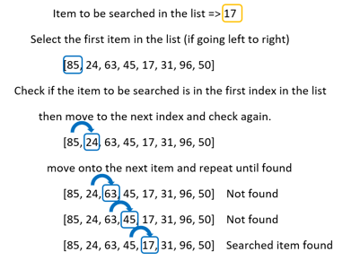
Linear Search
A linear search is an algorithm that iterates through each item in the list, comparing it to the item to be searched for.
First the algorithm starts at the first index (zero).
The algorithm tells the user the location (index) of the item in the list.
In this case 17 has an index of 4.

Slide 6
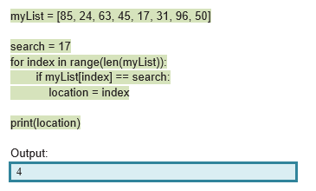
Linear Search
We can write this in Python (you can run the code via the link below).
https://repl.it/@suzannelinnane/Linear-Search-1

Slide 7
Linear Search
This works but it does not take into account some unpredicted outcomes.
For example, if the item to be searched is present more than once in the list or the algorithm does not find the item to be searched.

Slide 8
Linear Search - item present more than once
Let’s look at a list where the item is present more than once
If we ran the python code with this list then the output would be 7.
The index printed is index 7, the last item in the list.
This is because the algorithm continues through the list replacing the index value each time the item to be searched for is found.

Slide 9
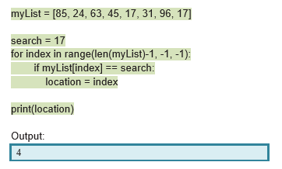
Linear Search - item present more than once
The following code would return the lowest index of the item to be searched.
This is because we have reversed the direction that the list is searched.
It still technically returns the last index, but as the linear search direction is reversed, this is the index with the smallest value: 4

Slide 10
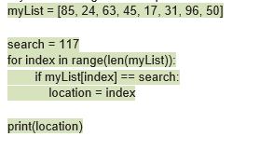
Linear Search - item not found
What would the output be if the searched item had a value of 117?
You can try it using the same code as before (in the Repl link) but change the search to 117.

Slide 11
Linear Search - item not found
The reason for the error is that the conditional statement (if myList[index] == search) was never entered because the item to be searched for was not present in the list. Therefore the location variable was never created.
In many other programming languages, instead of an error, you get an index of -1. This is because the lowest index in a list is 0, so -1 represents an index that does not exist.

Slide 12
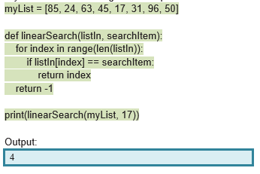
Linear Search
The following code solves our issues by using return to return the first index of the searched item as soon as it is found.
If the item to be searched is not present in the list, and the loop has finished, the function returns -1.
Try the code: https://repl.it/@suzannelinnane/Linear-Search-2

Slide 13

Binary Search
https://www.youtube.com/watch?v=8RPkQvkBBnQ

Slide 14
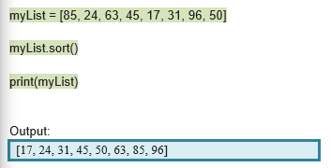
Binary Search
A binary search firstly assumes that the list is already sorted.
We can use the Python inbuilt sort() function to do this.

Slide 15
Binary Search
Once the list is sorted, we will look at the algorithm.
The binary search is often referred to as the half-interval search.
The algorithm employed is similar to how you might search through a deck of sorted cards. If you were searching for an 8 for example, you would select the middle card. If you card, 8 was the middle card, you found it. Otherwise, if your card was less than the middle card, you would focus your next search on the set of cards lower than the middle card. The same would apply if your card was larger than the middle card, you would focus on the cards greater than the middle card. This is repeated until either your card is found or it’s not in the list. This is how the binary search works.

Slide 16
Binary Search
When writing this program in python, there are several things we need to keep track of.
First and last index of where we are looking (to start off this will be the first and last index of the list). These will change as we focus on different parts of the list.
Half interval index (middle index between first and last index).

Slide 17
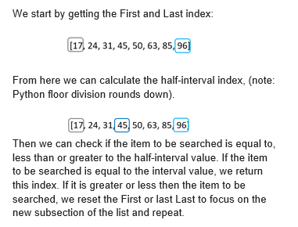

Slide 18
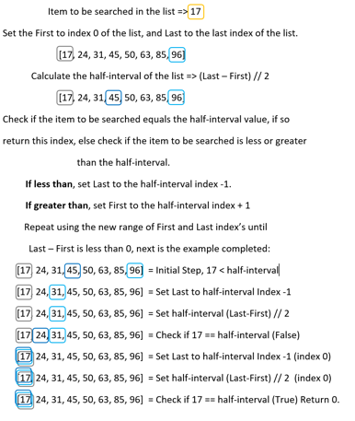

Slide 19
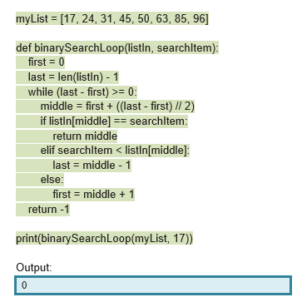
Binary Search - Python Code
Try the code: https://repl.it/@suzannelinnane/Binary-Search

Slide 20
Searching Algorithms
Linear Search
Straightforward and easy to understand
Data does not have to be sorted
Only suitable for very small datasets
Binary Search
Data must be sorted
More efficient than Linear Search on large datasets

Slide 21
Example: Step through how the binary search algorithm would find 99 in the following list.
7, 21, 52 ,59 ,68 ,92 ,94 ,99 ,133

Slide 22
Example: Step through how the binary search algorithm would find cherry in the following list.
apple cherry fig grape kale mango pear tomato

Slide 23
Example: Step through how the linear search algorithm would find 13 in the following list.
2 3 7 5 13 11

